Slide 1
Back swing
Pro screen shot
Your screenshot
SIMILARITIES
DIFFERENCES
Improvements
Give 5 ways you can improve your shot
Suggest reasons why these improvements would help your stroke

Slide 2
Club Used
Club Range in metres
Purpose of the shot
Variations it can have in a game of golf
What factors other than the swing can affect the success of the shot

Slide 3
GOLF

Slide 4
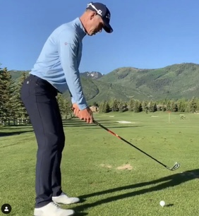
Preparation
SIMILARITIES
DIFFERENCES
Improvements
Give 5 ways you can improve your shot
Suggest reasons why these improvements would help your stroke

Slide 5
Down swing
Pro screen shot
Your screenshot
SIMILARITIES
DIFFERENCES
Improvements
Give 5 ways you can improve your shot
Suggest reasons why these improvements would help your stroke

Slide 6
Follow through
Pro screen shot
Your screenshot
SIMILARITIES
DIFFERENCES
Improvements
Give 5 ways you can improve your shot
Suggest reasons why these improvements would help your stroke

